Slide 1






Slide 2

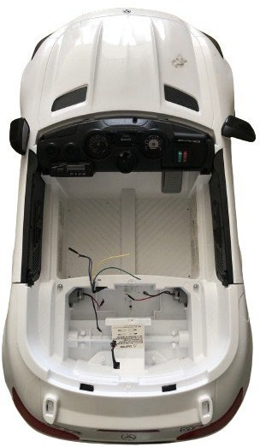
Children’s Electric Car
Vehicle body
Equipped with two rear-wheel drive motors and one steering motor
All three motors are DC motors for 12V
Steering Motors
Left rear wheel drive motor
Right rear-wheel drive motor

Slide 3
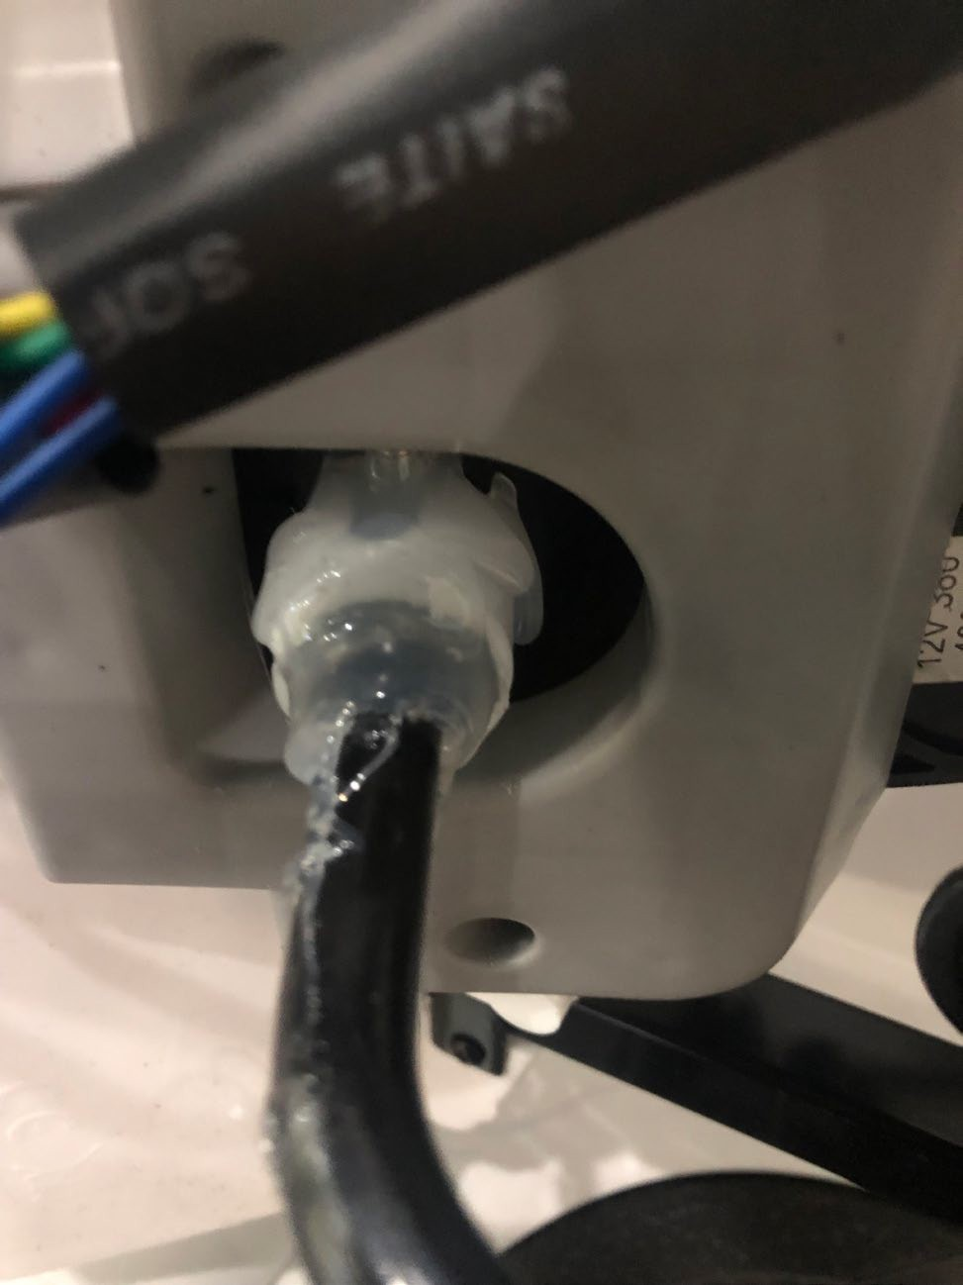
When turned the steering
If the steering motor does not sound for the entire steering radius...
Utilize a glue gun on the underside of the vehicle to secure the motor gearbox and rotating axle

Slide 4
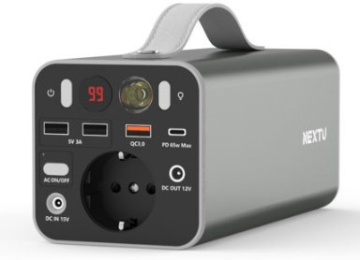
Battery
Power the electric car
Support 220V output
Battery Power ON/OFF
220V AC output ON/OFF
220V output
Charging Port

Slide 5
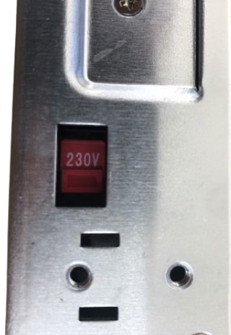
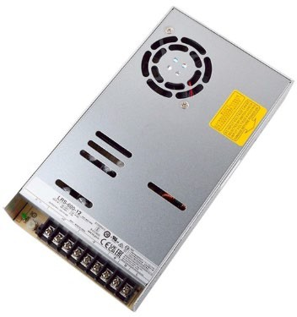
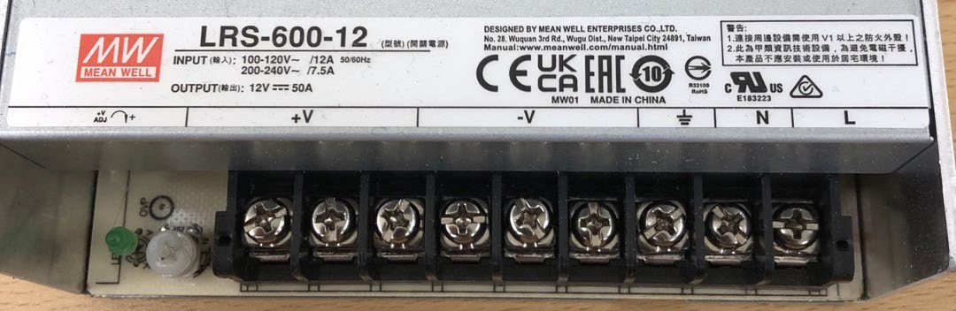
SMPS
Converting 220V AC Power to 12V DC Power
Set to 230V.
LED ON when AC OUTPUT Voltage
DC
AC INPUT
Automation Lab.
INPUT regulation
OUTPUT

Slide 6
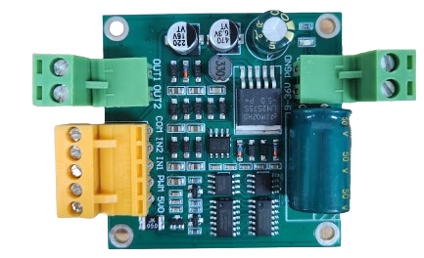
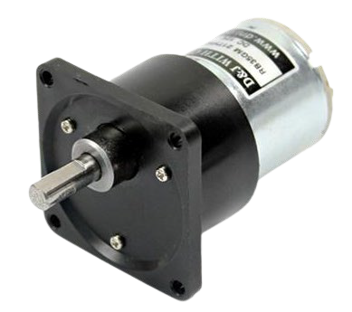
Motor Driver
Receives the output of the SMPS (12V DC) as the input of the motor driver
Receive control signals from Arduino
Applying the appropriate output voltage with the motor
Power
Motor Power
( - )
( + )
Motor Control
Motor Driver
Automation Lab.

Slide 7
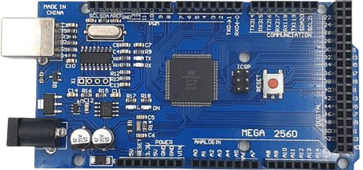
Arduino mega 2560
Ultra-compact computer to control multiple devices and sensors
Digital I/O Pins (PWM)
Communication Pin
USB
Connector
Digital I/O Pins
Automation Lab.
전원 핀
Analog Input Pins

Slide 8
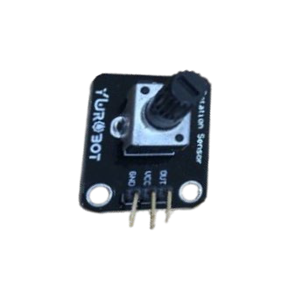
Variable Resistance
Resistance that can change the value of the current flowing through the circuit
Output the strength of the resistor as an analog value via the Output pin
Sweeper
3
(output)
1(GND)
2(5V)

Slide 9

Camera
Sensors to perceive your surroundings
Used to recognize lane information, traffic light information, etc.

Slide 10
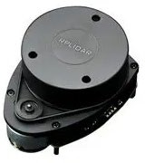

LiDAR
Sensors to perceive your surroundings
Used to recognize obstacle information, etc.

Slide 11
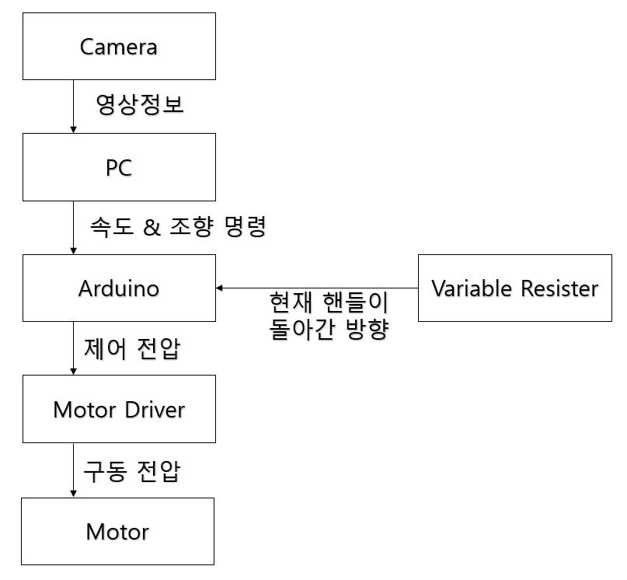
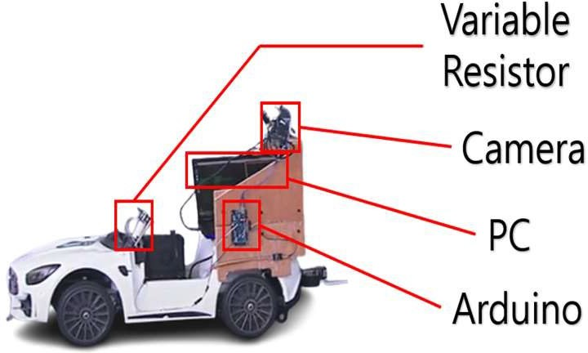


Finished vehicle appearance
Lidar
Lidar
각도별 거리 정보

Slide 12



Camera - PC
Lidar
각도별 거리 정보
Video Information
camera
Laptop

Slide 13

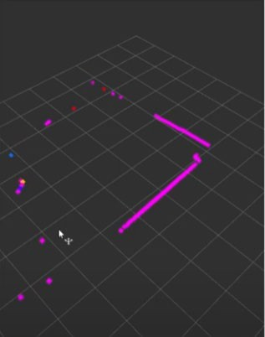
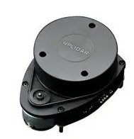

LiDAR - PC
Lidar
각도별 거리 정보
Distance information by angle
LiDAR
Laptop

Slide 14



PC - Arduino
Lidar
각도별 거리 정보
Speed: Slow Steering: Left
Laptop:
Based on sensor information Creating Speed & Steering Commands
Arduino

Slide 15

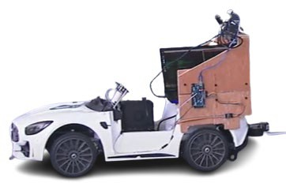
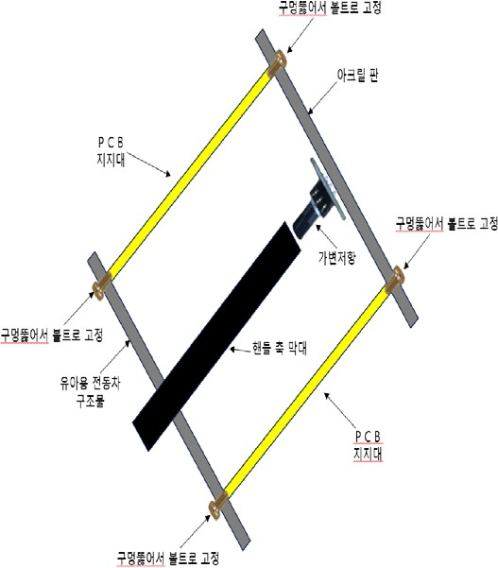


Arduino – Variable Resistor
Variable resistance is fixed to the axle of the vehicle steering w
The variable resistor sends information to Arduino about the di currently turned.
Lidar
heel
rection in which the handle is
각도별 거리 정보
Current Steering: Straight
Handle shaft
rotation
Holding the variable resistor to the handle axis
Arduino

Slide 16
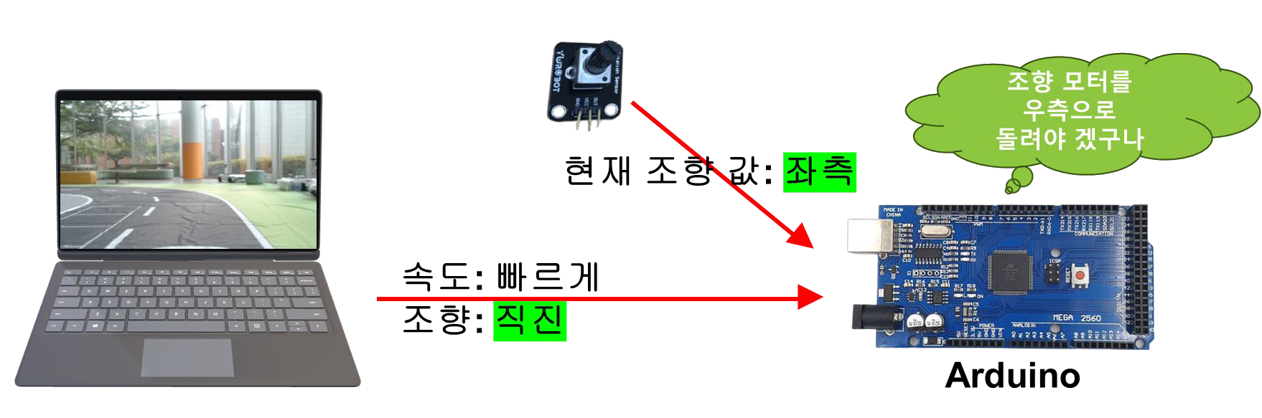

Arduino
PC로부터 속도 제어명령 받음
PC로부터 조향 제어명령 받음
가변저항으로부터 현재 조향 값 받음
Lidar
각도별 거리 정보

Slide 17


Arduino
Speed control commands from PC
Steering control commands from a PC
Receiving the current steering value from the variable resist
Lidar
각도별 거리 정보
or

Slide 18
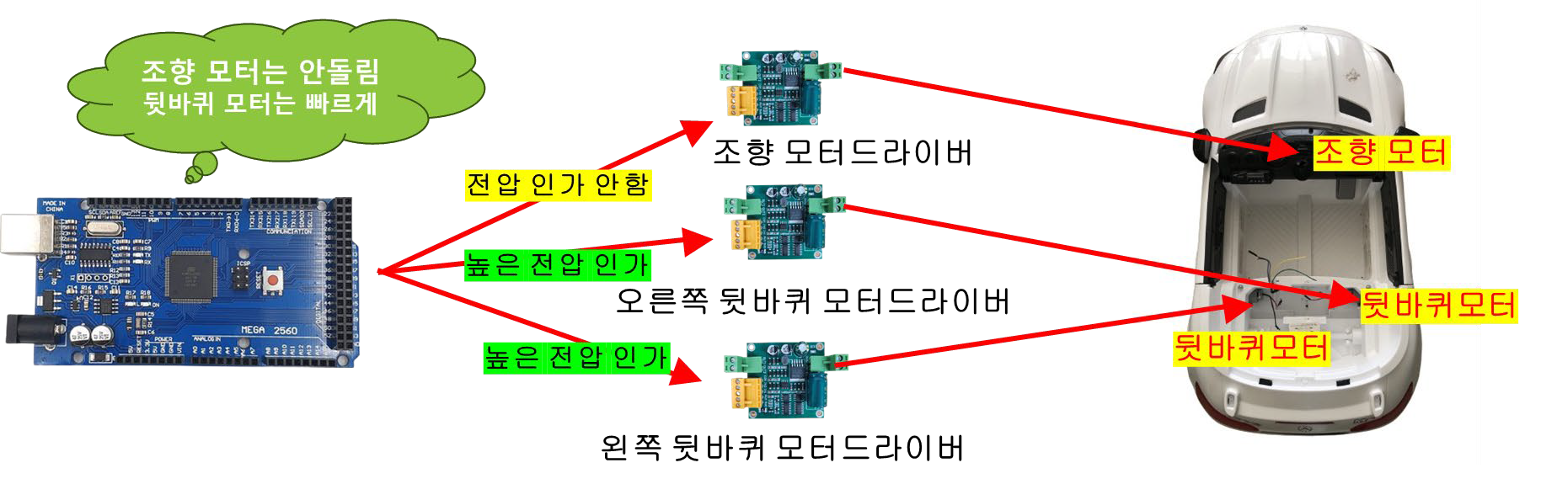
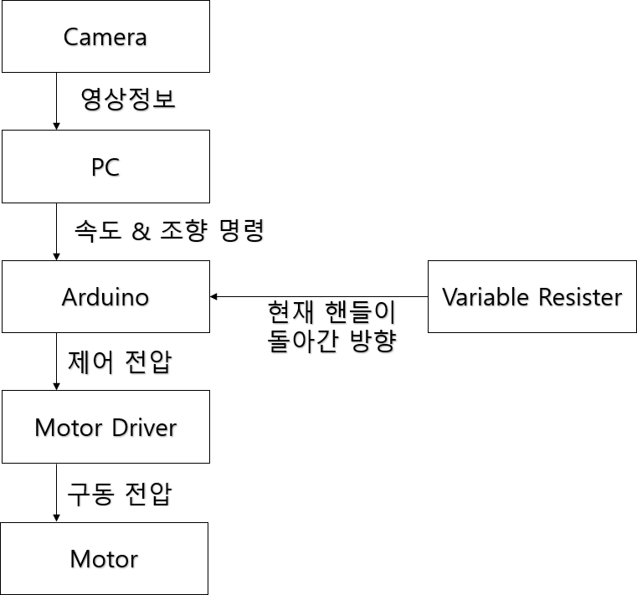

Arduino – Motor Driver – Motor
Arduino transmits control signals to the motor driver
The motor driver receives a control signal from Arduino
The motor driver applies voltage to the motor according to Arduino's control signal.
Lidar
각도별 거리 정보

Slide 19
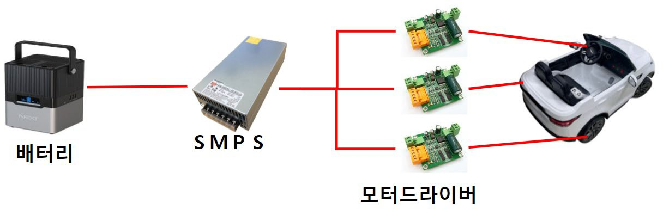
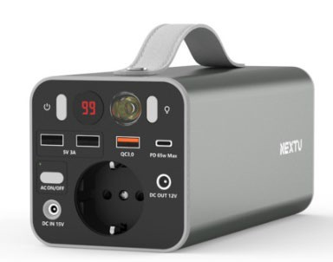

Power System Configuratio
Powered by electricit
Connected via battery as below
12V DC
220V AC
12V DC
12V DC

Slide 20
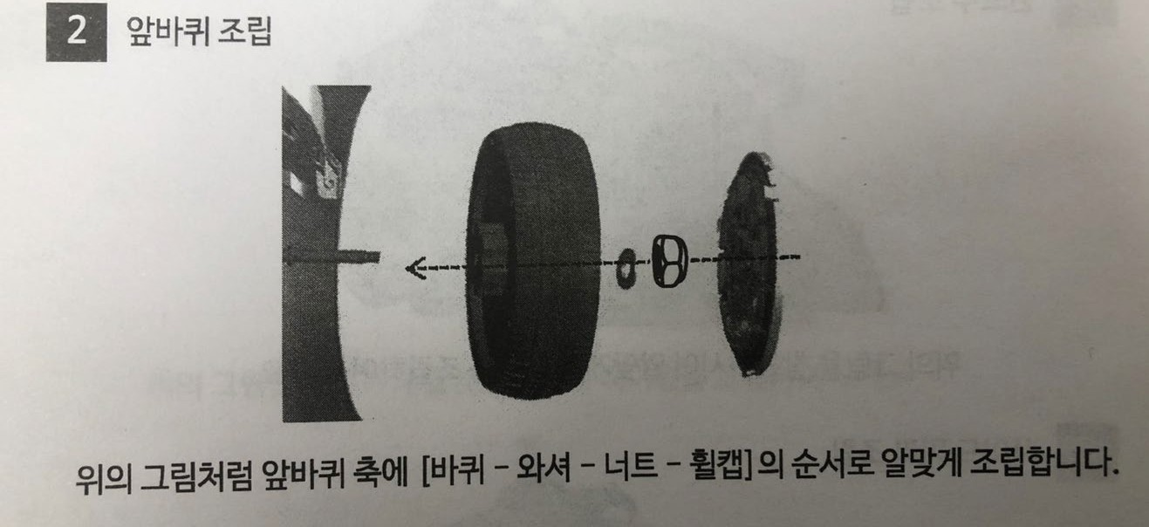
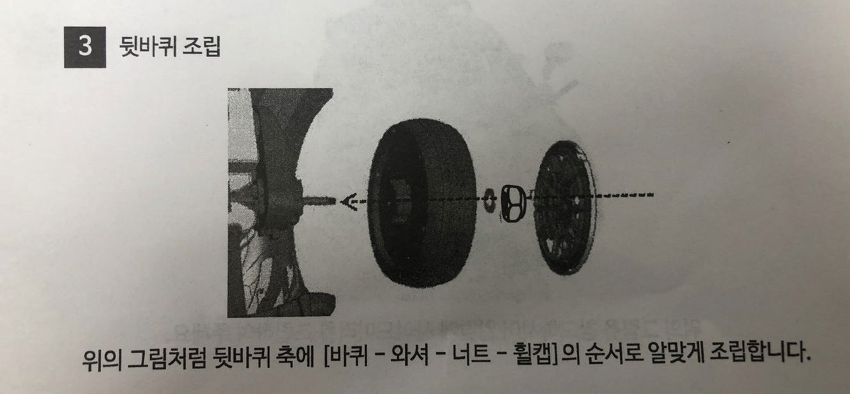

How to assemble the front and rear wheels

Slide 21

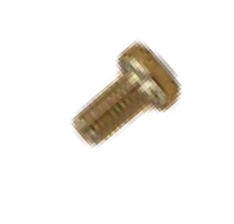
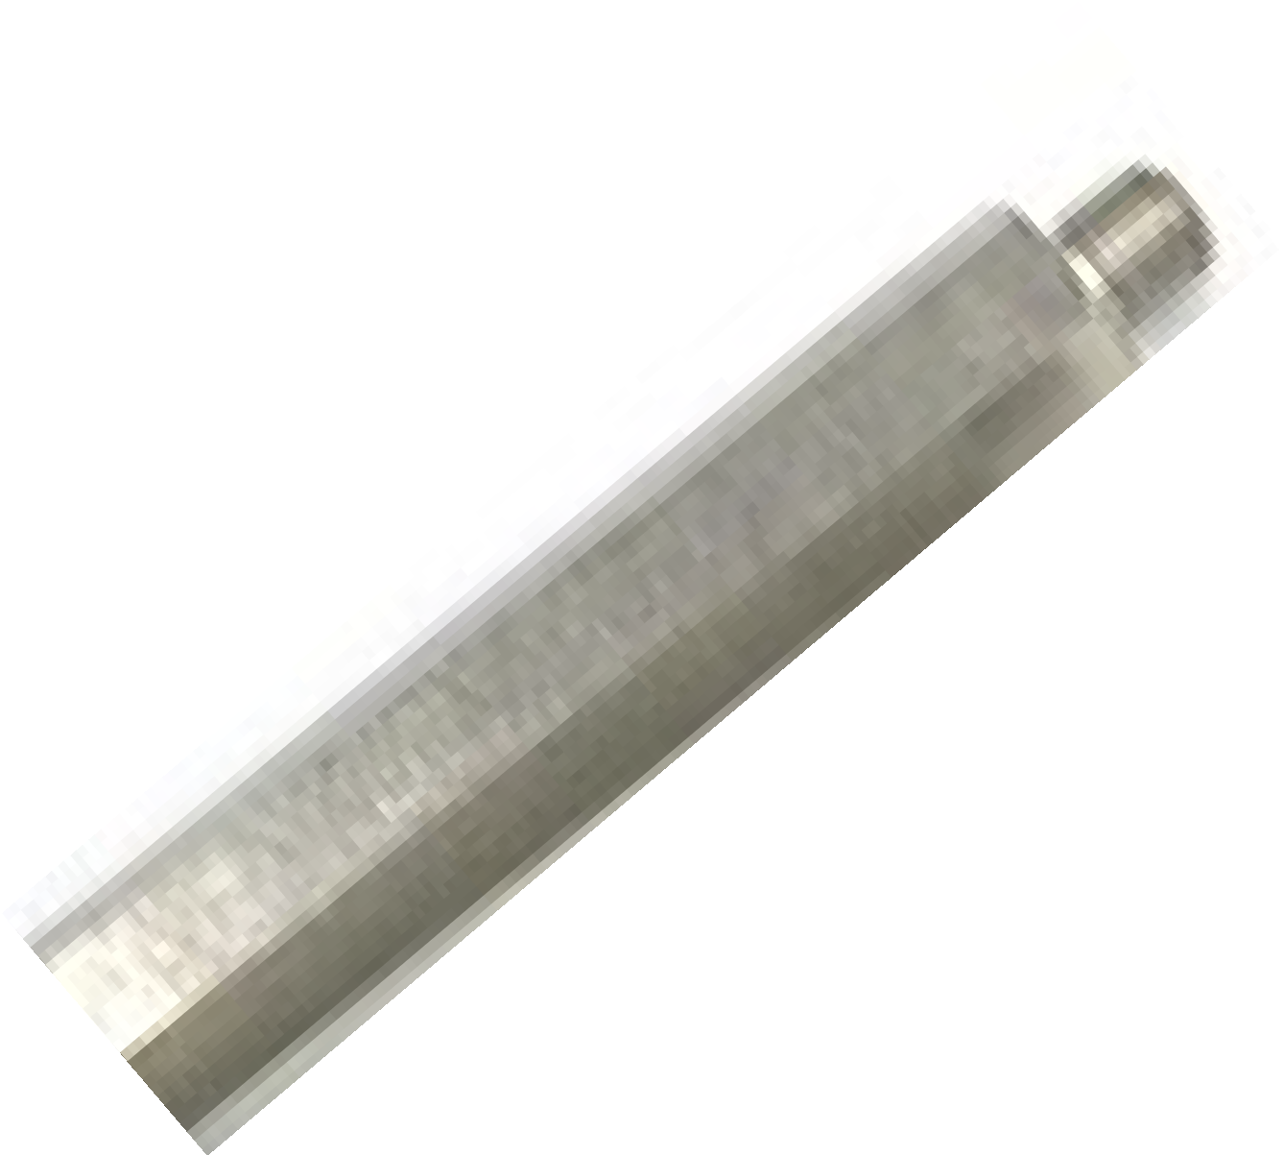


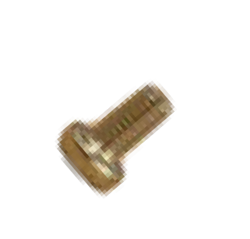
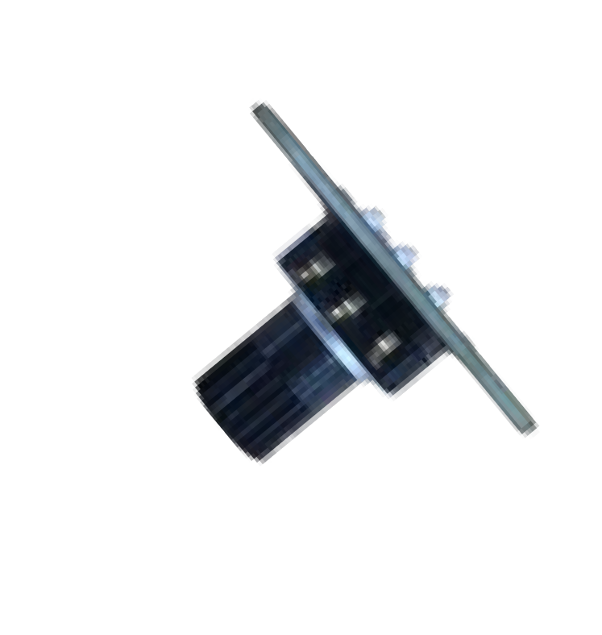

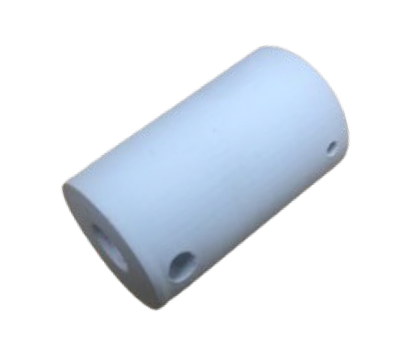

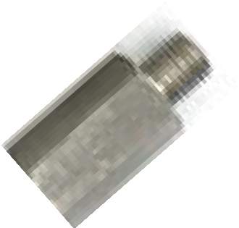


Summary diagram
PCB
Support
board
PCB
Support
insertion
insertion
Drill holes and bolt them
Children’s electric car Structure
PCB
Support
Handle Axle Rod
Variable resistance
PCB
Support
Drill holes and bolt them

Slide 22
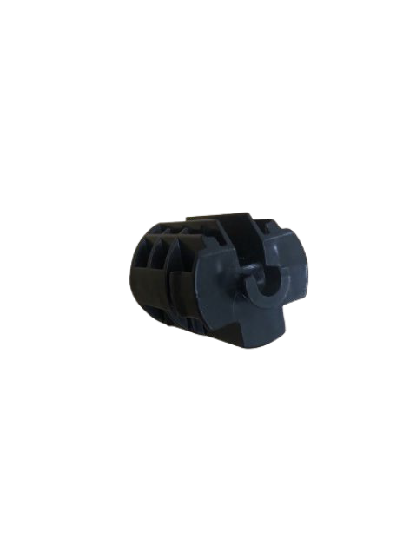

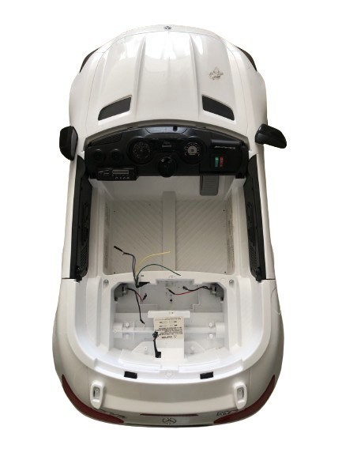

Removing an Existing Mount
Removing the mount

Slide 23
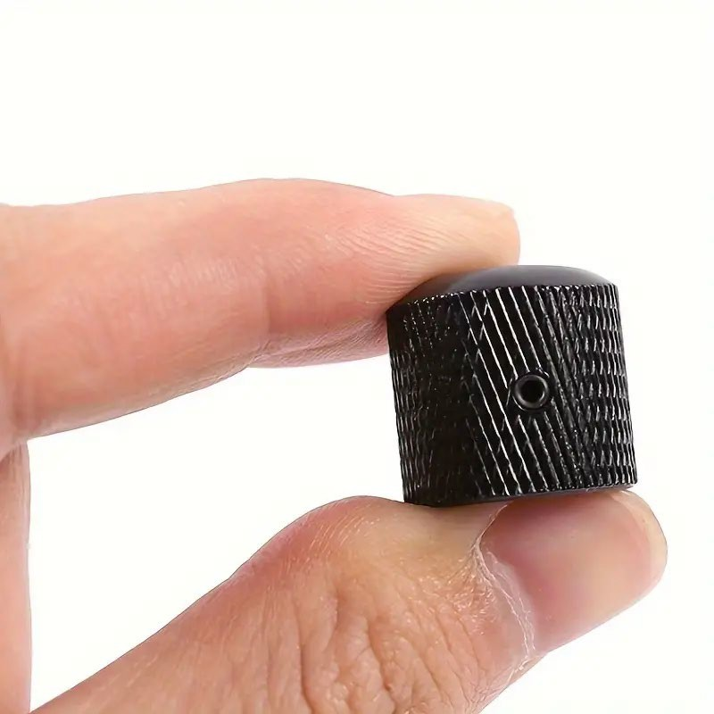
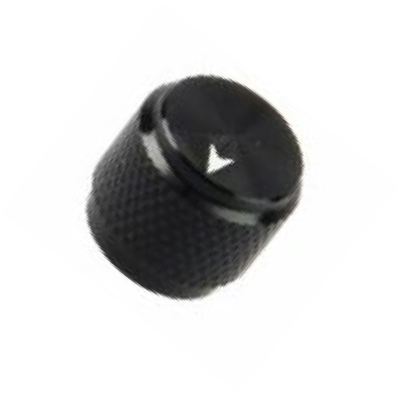
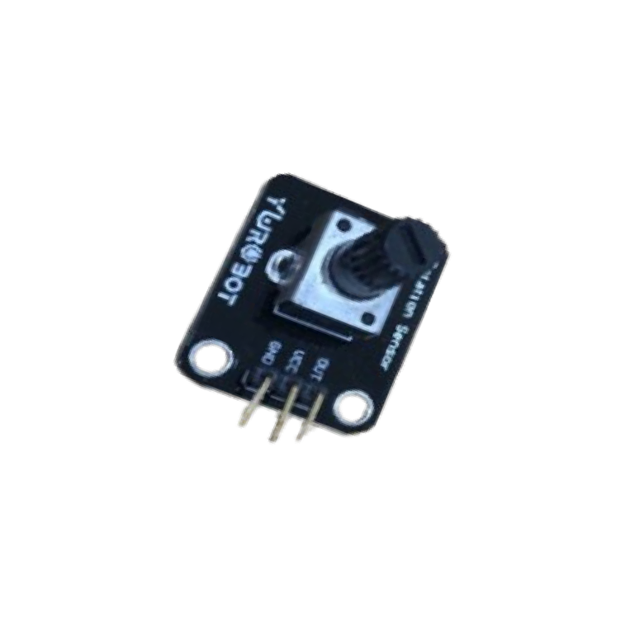

Variable resistance + metal cap coupling
insertion
Utilize a hexagonal screwdriver to remove small screws
Automation Lab.

Slide 24
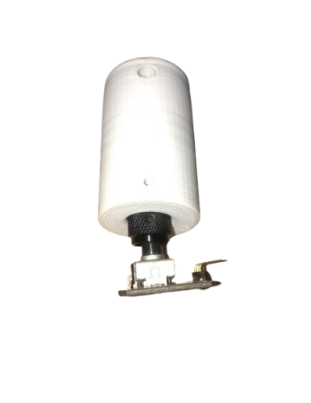
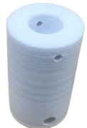
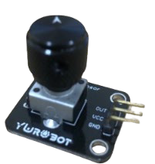

Variable resistance + Metal Cap+ 3D Printing Mount combination
Metal cap bonding on the side close to the small hole
insertion
Matching metal cap hole and mount hole
Automation Lab.

Slide 25
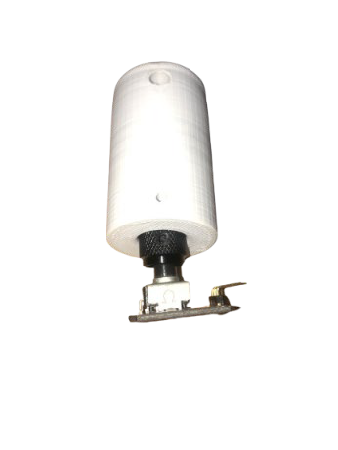
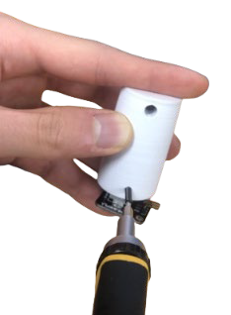
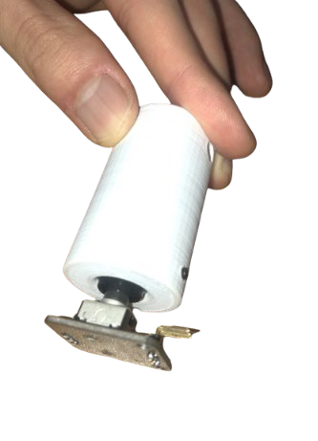
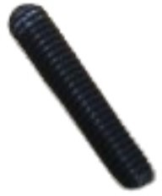

Variable resistance + Metal Cap+ 3D Printing Mount combination
The hex screw sticks out very slightly, and it is well enough to hold
Inserting a hex screw into the hole to secure it
Matching metal cap hole and mount hole
Be careful not to forcibly turn the hex screw without properly matching the metal cap hole and the mount hole, as the metal cap will break.
Hexagonal shape screwdriver Inserting hex screws using
Inserted Finished Appearance
Automation Lab.

Slide 26
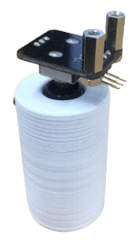
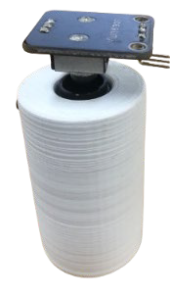


Variable resistance + Metal Cap+ 3D Printing Mount combination
Insert 2 1cm PCB supports from top to bottom
2 nuts joined from bottom to top
1cm PCB Support Combined Appearance

Slide 27
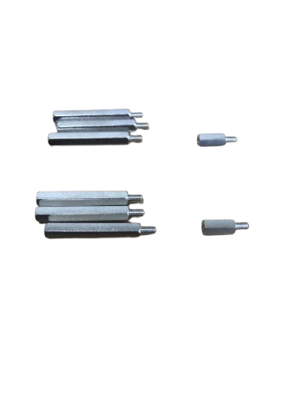
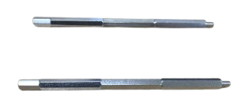

Coupled to the body with variable resistance
The bottom is joined by 1 cm
Combine PCB supports to create two 10 cm long rods

Slide 28
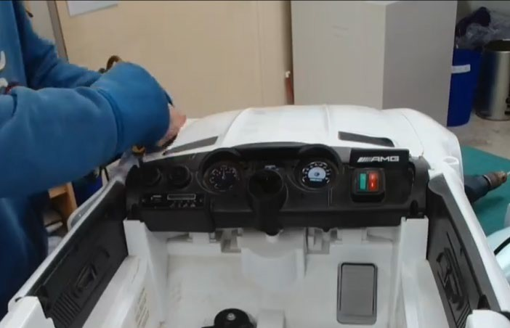
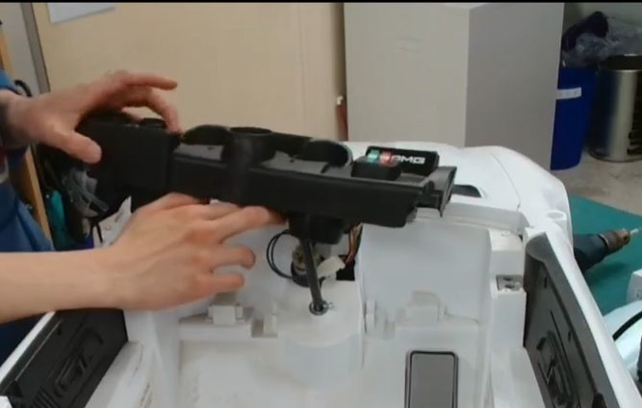

Coupled to the body with variable resistance
Subtracting the front structure of the vehicle
Using a Screwdriver Don't lose the screw you removed

Slide 29
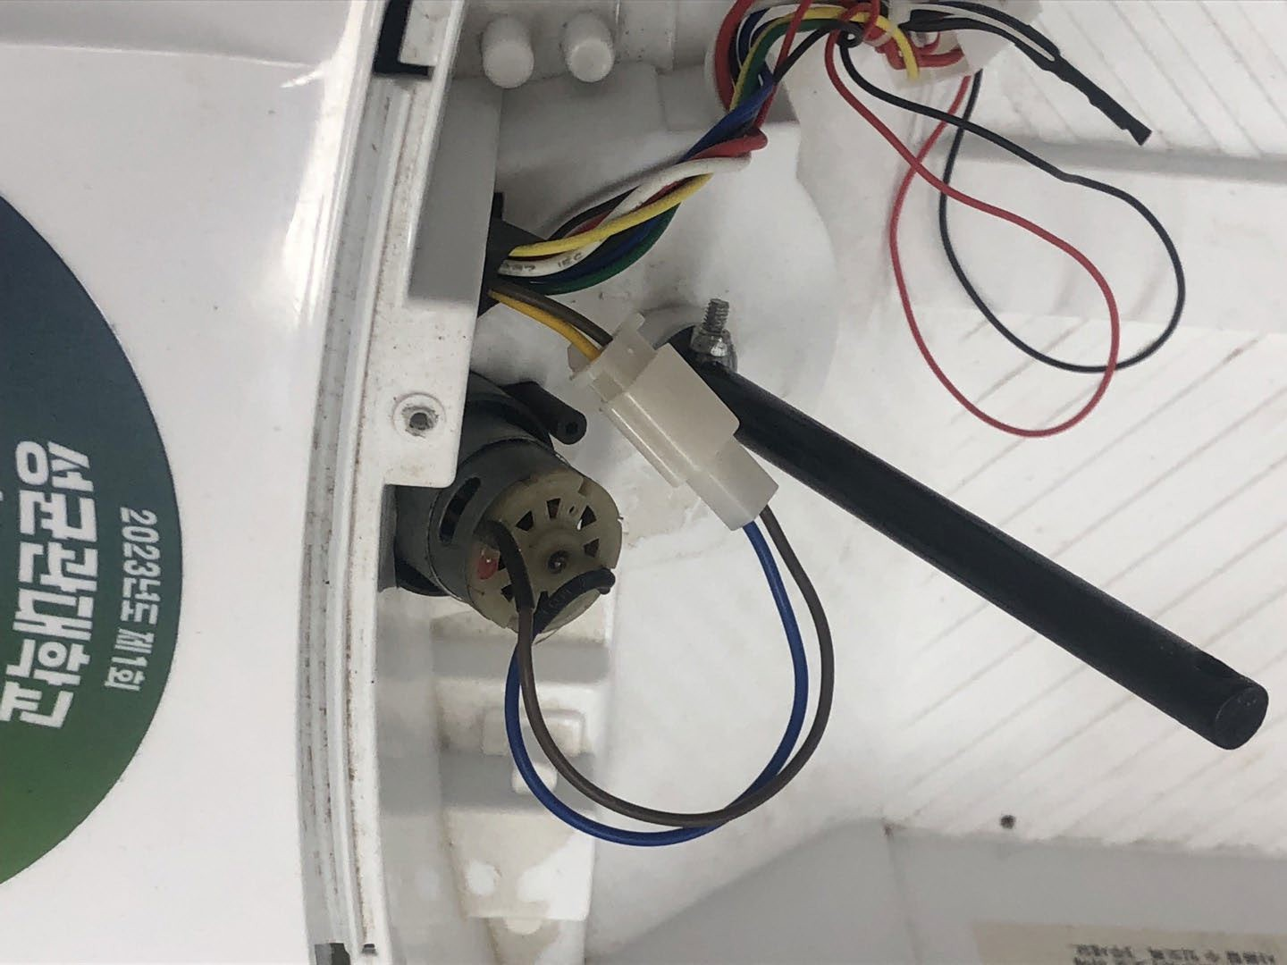

What to check in advance for the subsequent process
Check the color of the steering motor connection line
<Check the line color>
This line connects to the rear of the vehicle

Slide 30
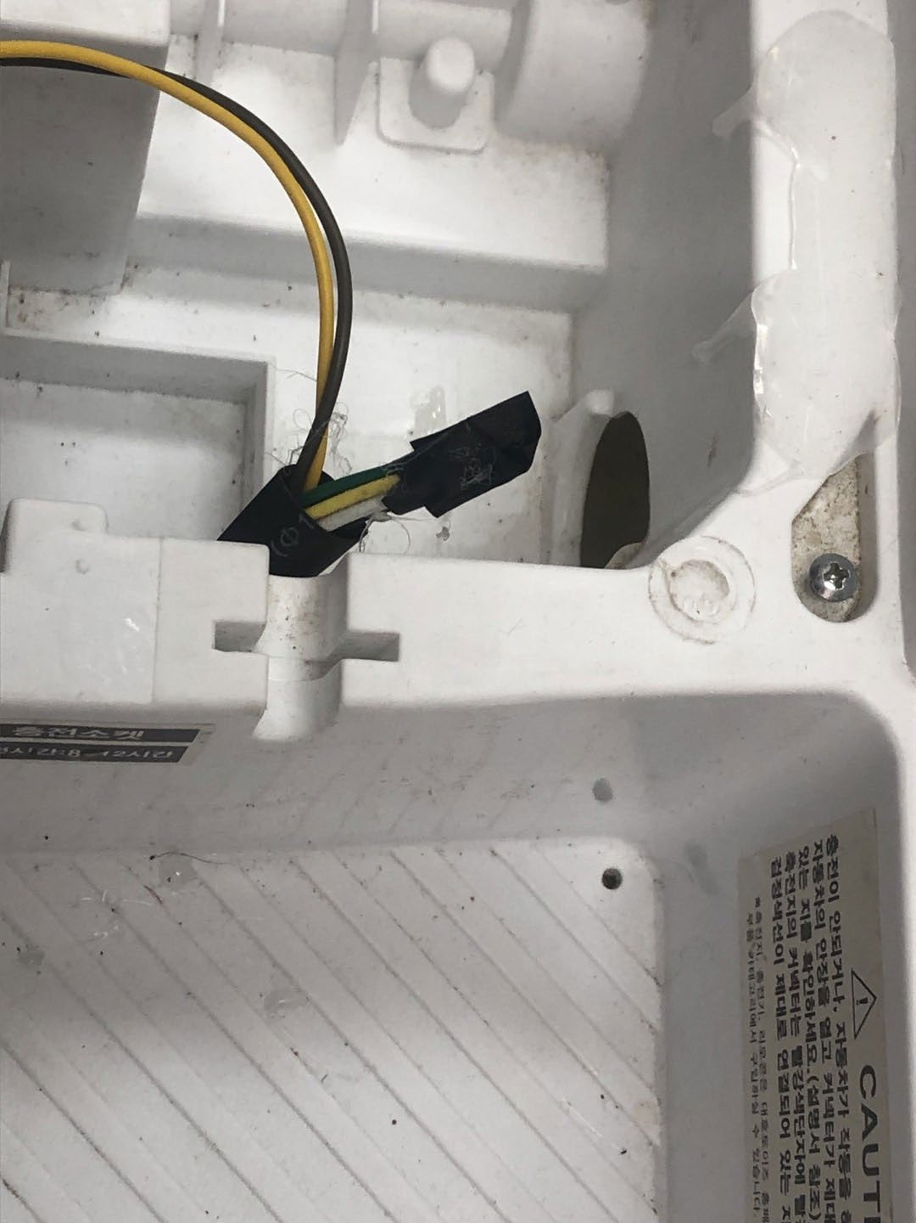


Check list
The wire connected to the steering motor at the front is connected to the rear of the vehicle
Determine which line at the rear of the vehicle is connected to the steering motor

Slide 31





Coupled to the body with variable r
esistance
Inserting the bolt into the hole
Children’s electric car Structure
If there is a hole in the structure
Inserting the bolt into the hole
If there are no holes in the structure or if the holes are too large and loose
Ask a teaching assistant to drill a hole

Slide 32

Coupled to the body with variable resistance
PCB Support Fixation and Recombination
Using a Screwdriver

Slide 33






Coupled to the body with variable resistance
Attach the mount to the vehicle steering wheel axle
Matching mount hole and handleshaft hole
Set to rotate freely left
and right

Slide 34






Coupled to the body with variable resistance
Put the top plate on top and secure it with bolts and nuts
Large bolts and nuts secure the mount

Slide 35




Coupled to the body with variable resistance
Put the top plate on top and secure it with bolts and nuts
Combined with bolts
Combined with nuts
Top Plate Bonding

Slide 36

Power System Configuratio
Powered by electricity
Connected via battery as below
12V DC
220V AC
12V DC
12V DC

Slide 37

Motor driver - Motor
12V DC
220V AC
12V DC
12V DC

Slide 38

Motor driver - Motor
The wire connected to the steering motor at the front is connected to the rear of the vehicle
Determine which line at the rear of the vehicle is connected to the steering motor
Previously performed during the fixed of the variable resistor

Slide 39





Motor driver - Motor
Leaving the wire connected to the rear wheel motor
Leaving a line connected with the steering motor
Remove the rest
Wire connected to steering motor
Lines connected to the rear wheel motor

Slide 40






Motor driver - Motor
Connect
Connect
Connect
Connect
Connect
Connect

Slide 41




Motor Driver – Motor
Disconnect the connector

Slide 42





Motor Driver - Motor
Rotate counterclockwise using a flathead screwdriver
Insert Line
Rotate clockwise using a flathead screwdriver to secure

Slide 43


Motor Driver - Motor
The motor should be connected to OUT1 and OUT2.
PGND, should not be connected to 9-36V.
Automation Lab.

Slide 44


Motor driver – SMPS

Slide 45




SMPS – Motor driver
Connect
Connect

Slide 46












SMPS – Motor Driver
+V: Connect the red line
-V: Connect the black line
DC OUTPUT part 6 screws using a Phillips screwdriver
Rotate counterclockwise to connect, then rotate clockwise again to secure
LED ON When AC OUTPUT Voltage
DC
AC INPUT
Automation Lab.
INPUT Regulation
OUTPUT

Slide 47






SMPS – Motor Driver
Red Line: 9-36V
Black Line: PGND
If the position of each color changes, the motor driver will spark and malfunction!
Be sure to check the letters 9-36V, PGND.
(9-36V)
(9-36V)
(PGND)
(PGND)

Slide 48

SMPS – Motor Driver
Rotate counterclockwise using a flathead screwdriver
Insert line
Rotate clockwise using a flathead screwdriver to secure

Slide 49

Battery - SMPS

Slide 50












Battery - SMPS
Connect the green wire to
Connect the brown/blue wire to
AC INPUT part 3 screws Using a Phillips screwdriver Rotate counterclockwise to
connect, then rotate clockwise
AC INPUT
Automation Lab.
again to secure

Slide 51





Connecting the Control Unit
Variable resistance
Motor Driver

Slide 52

Laptop – Arduino
Variable resistance
노트북 PC
아두이노
Motor Driver

Slide 53


Laptop – Arduino
Connect using a USB serial cable

Slide 54

Arduino - Motor Driver
Variable resistance
Laptop
Arduino
Motor Driver

Slide 55







Arduino – Motor Driver
PWM Pins
Motor Control Unit
GND
VCC
5V
GND
Motor Driver

Slide 56

Arduino – Motor Driver
Connect using jumper lines
Left rear wheel motor driver IN1 – connected to Arduino pin 6
Left rear wheel motor driver IN2 – connected to Arduino pin 7
Right rear wheel motor driver IN1 – connected to Arduino pin 4
Right rear wheel motor driver IN2 – connected to Arduino pin 5
Steering motor driver IN1 – connected to Arduino pin 2
Steering motor driver IN2 – connected to Arduino pin 3

Slide 57

Arduino - Variable resistance
Variable resistance
Laptop
Arduino
Motor Driver

Slide 58


Arduino – Variable Resistance
Variable Resistor OUT - Connected to Arduino A2 Pin
Variable Resistor VCC - Connecting to Arduino 5V Pin
Variable Resistor GND to Arduino GND Pin

Slide 59





Arduino IDE execution
Click File -> Click Open
Select (ros2_ws/src/control/motor_test/~.ino), click the Open button
59

Slide 60



핀번호 및 속도 값 입력 후 업로드

